Slide 1
Reviewer Rebuttals 11/19/19

Slide 2
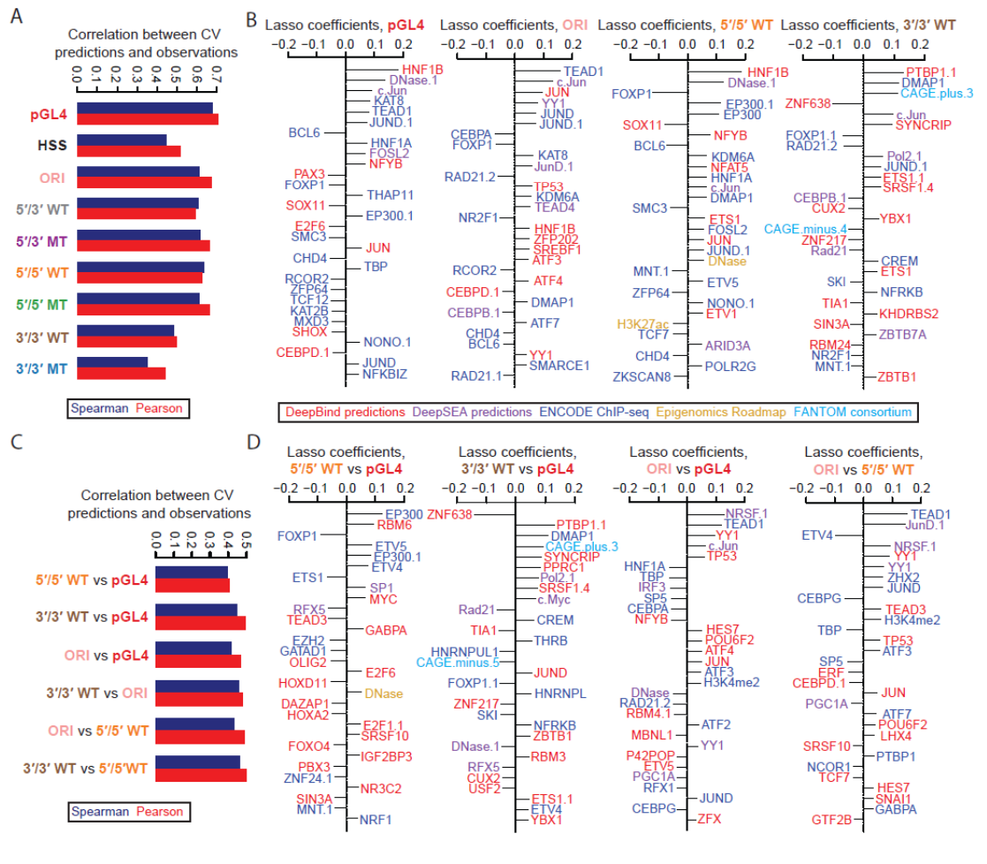
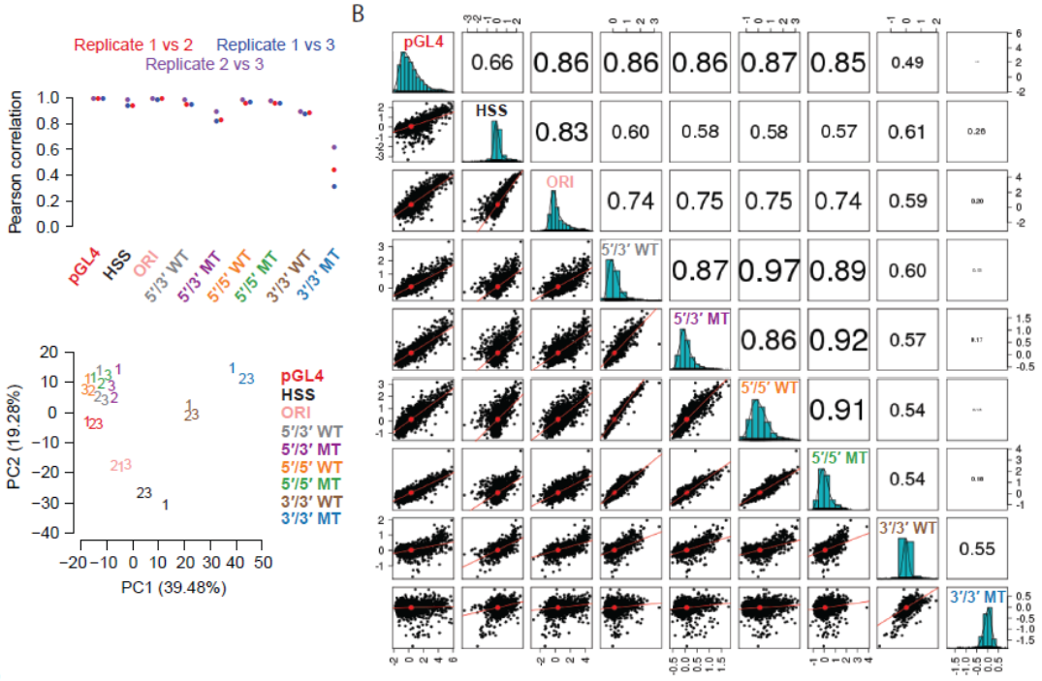
As the experiments with the “3’/3’ MT” setup are not reproducible and essentially failed (“3’/3’ MT...exhibited poor technical reproducibility”, page 9), the respective datasets should not be analyzed and such analyses (e.g. those in fig. 3) should be removed.

Slide 3
“…no attempt was made to decorrelate the input covariates (e.g PCA). The results of the model are presented in a very qualitative way. No p-values, effect sizes or variance explained are reported for any of the parameters in the model, making it impossible to ascertain the importance of the input variables. The results from the regression model do not justify any strong conclusions about what variables best explain the data.”
Effect sizes are provided as coefficients
p-value’s goal is to test null hypothesis that a coefficient is nonzero in a linear model, lasso balances model complexity and performance so all coefficients nonzero were kept for reason and p-values don’t make sense
Coefficient is relevant measure of feature importance in joint model of all features together, tables provided to compute variance explained can be computed easily for every variable (including those not selected)
Limits of PC Regression (http://www.milanor.net/blog/performing-principal-components-regression-pcr-in-r/):
Not a feature selection method, all >1000 features would remain in model
“The directions that best represent each predictor are obtained in an unsupervised way. The dependent variable is not used to identify each principal component direction. This essentially means that it is not certain that the directions found will be the optimal directions to use when making predictions on the dependent variable.”
Almost everywhere I read suggests that interpretation becomes even more difficult

Slide 4
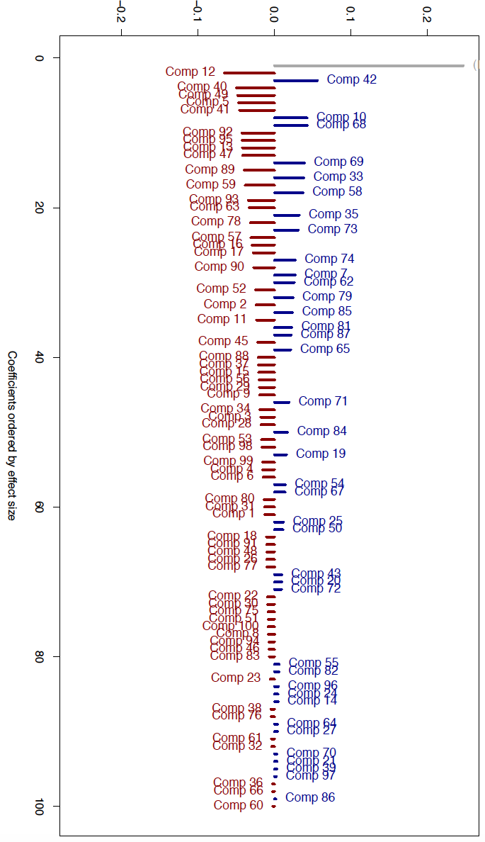
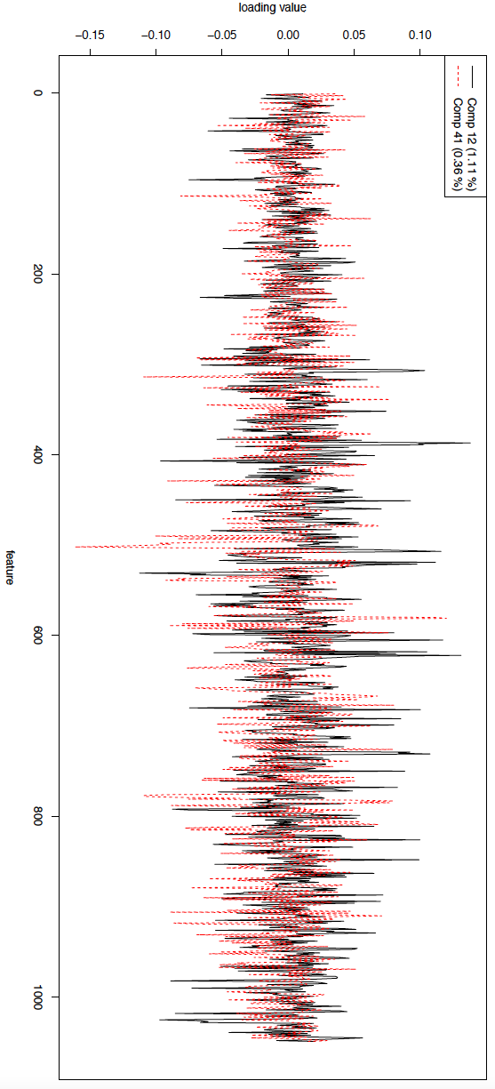
PC Regression model for ORI
r² = 0.47

Slide 5
“I have serious concern lasso regression is not the correct analysis approach here. Given many of the features included in the regression are highly correlated, selection of top ranking features could be arbitrary and generate misleading rankings when comparing between assays. Elastic nets would likely be a better approach.”
“We caution that the interpretation of feature selection and coefficient-based ranking is inherently limited by the substantial degree of multicollinearity among features (Supplemental Table 4), which in turn limits the determination of which features are mechanistically or causally involved. Potential reasons for inter-feature correlations include…. Of note, another potential confounder is that the criteria used to select elements relied on features including FOXA1/2, HNF4A, EP300, H3K27ac, CHD2, RAD21, and SMC3 ChIP peaks¹³, which could exaggerate the contributions of these factors, or bias the contributions of other features, in models attempting to predict general enhancer activity in HepG2 cells.”
Elements of Statistical Learning (Hastie, Tibshirani, Friedman)
“principal components regression is very similar to ridge regression: both operate via the principal components of the input matrix. Ridge regression shrinks the coefficients of the principal components, shrinking more depending on the size of the corresponding eigenvalue; principal components regression discards the p − M smallest eigenvalue components.”
PLS, PCR, and ridge regression tend to behave similarly. Ridge regression may be preferred because it shrinks smoothly, rather than in discrete steps. Lasso falls somewhere between ridge regression and best subset regression, and enjoys some of the properties of each.
Use of the L1 penalty follows what we call the “bet on sparsity” principle for high-dimensional problems: ‘Use a procedure that does well in sparse problems, since no procedure does well in dense problems’.
“Qualitatively speaking, a regression method exhibits the grouping effect if the regression coefficients of a group of highly correlated variables tend to be equal (up to a change of sign if negatively correlated). In particular, in the extreme situation where some variables are exactly identical, the regression method should assign identical coefficients to the identical variables.” (Hui Zou and Trevor Hastie 2005)
In both this method, PC regression, and Random Forest, correlated variables would split the weight equally among variables, deflating the importance of the feature as a function of the number of other correlated features that exist
This makes the rankings even less interpretable than lasso. While lasso is imperfect in that it may select one feature over another similar one, the top coefficients reflect the collective value of a group of related features. Feature correlation matrix can easily be used to generate hypotheses about related features.

Slide 6
Elements of Statistical Learning (Hastie, Tibshirani, Friedman)

Slide 7
Overall, can see that alternative methods have the undesirable property that, by including more variables, those that are correlated to other included variables get deflated in their importance, so independent variables tend to rise to the top of feature importance rankings
My preference would be to show these results and excerpts from statistics/ML literature to reviewers, to demonstrate why neither of their recommendations helps improve feature interpretation but rather why each method has its own nuanced limitations
Suggestion of what to do
Simplest but most useful thing to do would be to add a new figure taking the union of all top 30 regression coefficients for all regression models, and displaying a correlation matrix showing all other features with Pearson correlation ~ >0.7 to this group
Will allow us to highlight the problem of multicollinearity more in the text, and discuss the other features in these groups that might play a role
Expand discussion in main text further justifying the use of lasso while describing both its limitations and those of ridge/elastic net/PCR/Random Forest.

Slide 8
“Line 419: The authors comment that there is consistency in the difference between WT and MT as reported in Inoue et al 2017. Are the differences observed in the MT assay shared with ORI, HSS and pGL4?”
Excerpt from text: “Furthermore, as we previously showed for the 5′/3′ WT and 5′/3′ MT assays, enhancer activities as measured by MPRAs are reasonably well predicted by models based on primary sequence together with biochemical measurements at the corresponding genomic locations. Nonetheless, despite the general agreement, there are clear systematic differences that are predictable by similar features, consistent with what we previously observed in comparing 5′/3′ WT vs. 5′/3′ MT MPRAs”
Don’t fully understand question

Slide 9
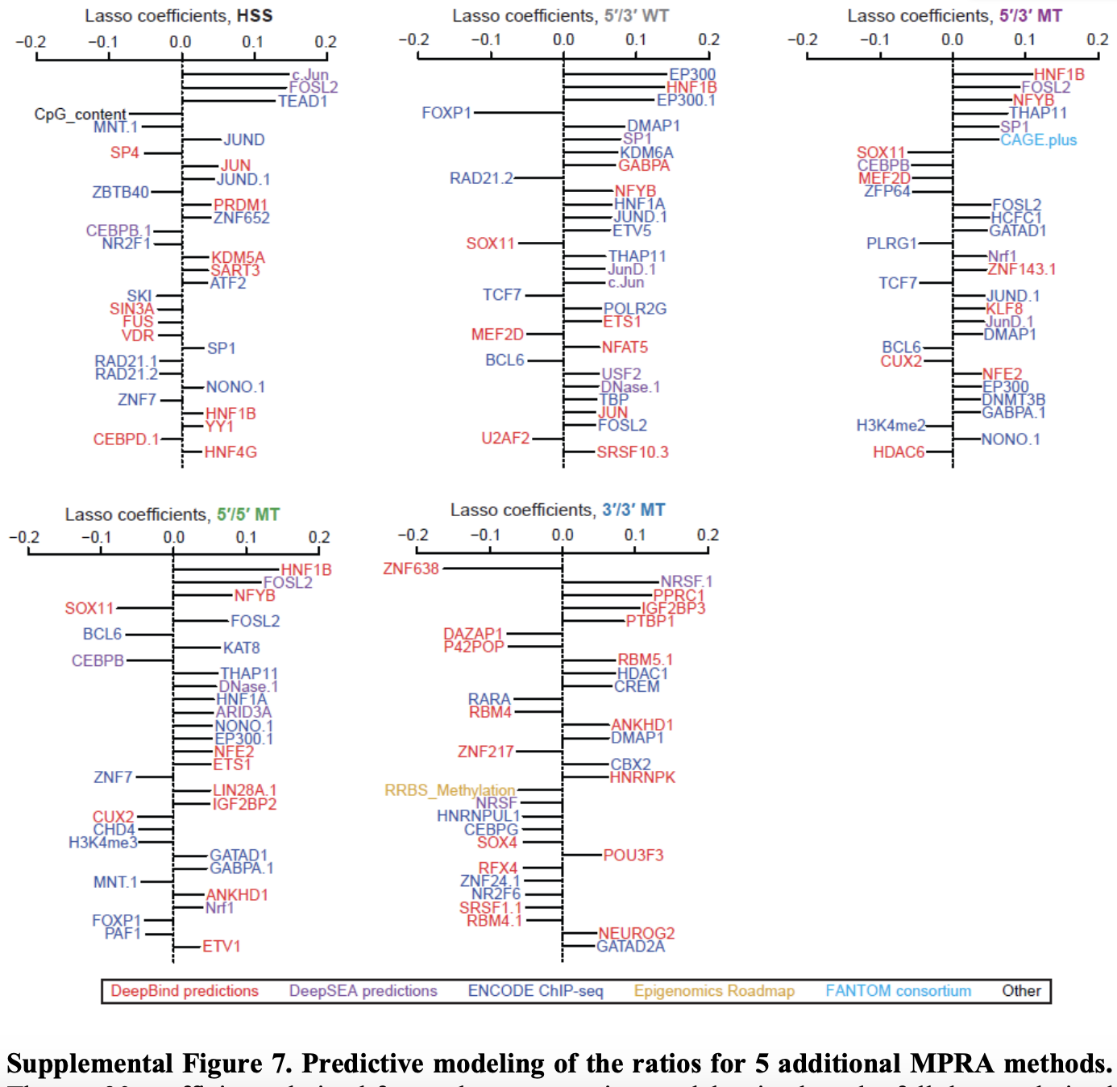
“Please add WT/MT (5’ & 3’) lasso (or elastic net) coefficient plots to the supplement.”

